Slide 1
Conference Program Sponsored by:
Trade Policy in the Executive Branch and Beyond
Presenters:
Nicole Bivens Collison, Sandler, Travis & Rosenberg
Cynthia Whittenburg, NEI

Slide 2
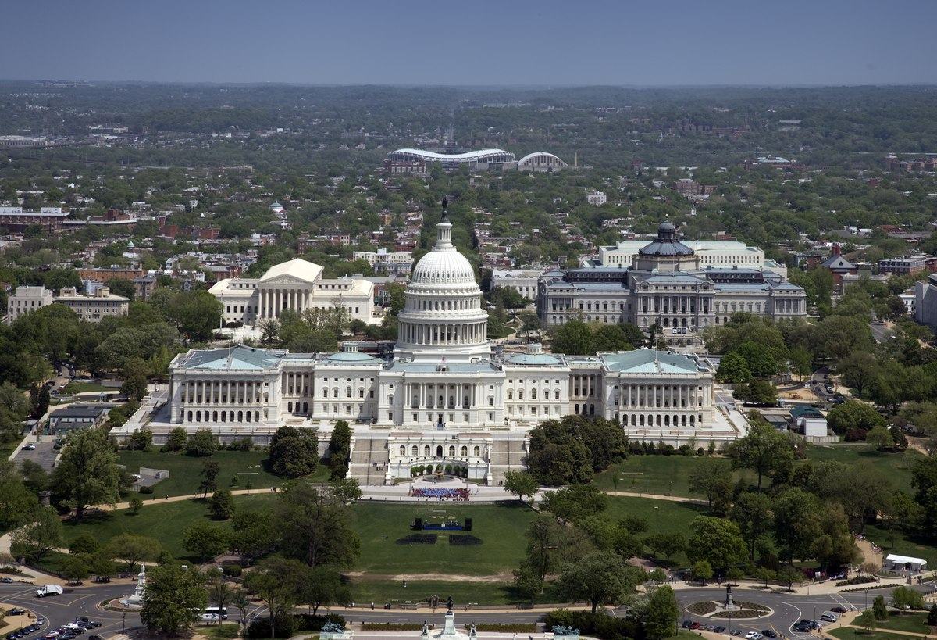
Trade Policy in the Executive Branch and Beyond
Topics for discussion…
Executive Branch Trade-Related Roles
Congressional Trade-Related Roles
Judicial Role
World Trade Organization
World Customs Organization
Current Legislative Actions
This Photo by Unknown Author is licensed under CC BY-SA

Slide 3
Trade Policy in the Executive Branch and Beyond
Why do you need to have this information?

Slide 4
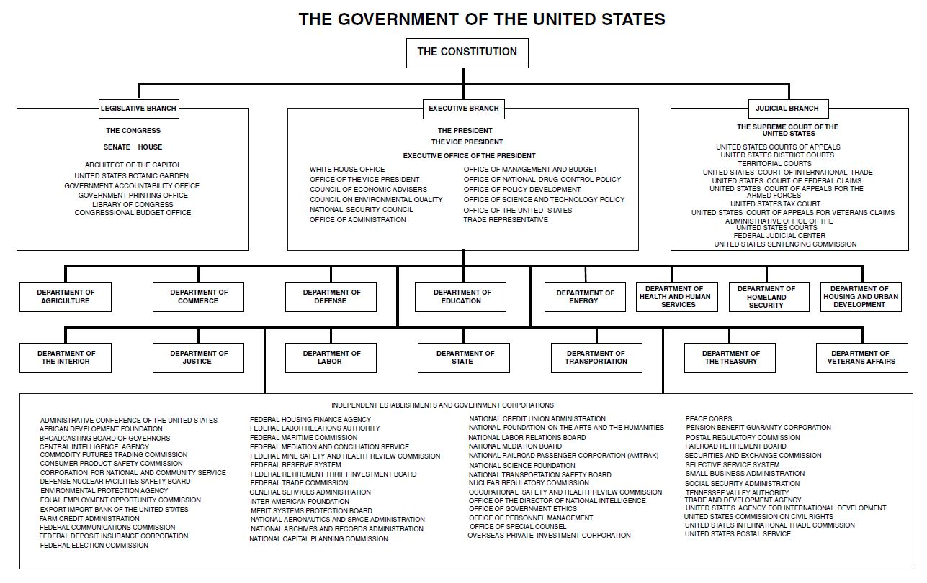
Trade Policy in the Executive Branch and Beyond
This Photo by Unknown Author is licensed under CC BY-SA-NC

Slide 5
Trade Policy in the Executive Branch and Beyond
White House
National Security Council
U.S. Trade Representative
Department of Homeland Security
Customs and Border Protection
Transportation Security Administration
Department of Treasury
Department of Commerce
International Trade Administration
Department of Labor
Department of State
International Trade Commission

Slide 6
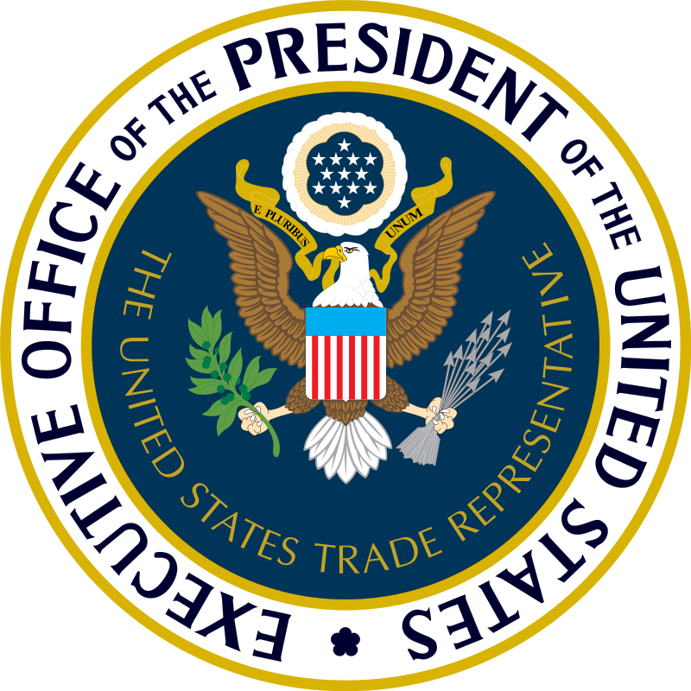
Trade Policy in the Executive Branch and Beyond
White House
National Security Council
President’s principal forum for national security and foreign policy decision making
Includes international economics issues – regularly attended by USTR and Secretary of Commerce
U.S. Trade Representative (USTR) → Katherine Tai
Acts as President’s principal advisor on trade policy, chief U.S. trade negotiator, and head of the interagency trade policy coordinating process.
USTR administers U.S. law to combat “unfair” foreign trade practices (e.g., “Section 301”), and trade preference programs for developing countries.

Slide 7
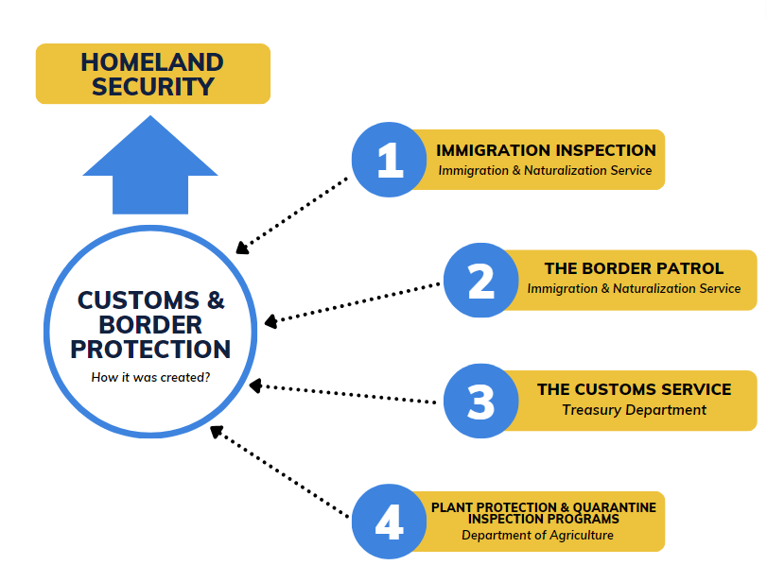
Trade Policy in the Executive Branch and Beyond
Department of Homeland Security → Secretary Alejandro Mayorkas
Formed in response to September 11 attacks
Seeks to secure U.S. borders while enabling legitimate trade.
Customs and Border Protection (CBP)
Facilitates the flow of goods through U.S. ports of entry.
Collects tariffs and enforces trade laws at the border.
Works with DHS’s Immigration and Customs Enforcement (ICE)
Transportation Security Administration (TSA)
Ensure free and secure movement of people and commerce
Air cargo screening

Slide 8
Trade Policy in the Executive Branch and Beyond
Department of Commerce → Secretary Gina Raimondo
Promote U.S. international trade, economic growth, and technological advancement
Prevent unfair foreign trade competition
International Trade Administration
Provides market research, business connections, and other services to promote U.S. exports and attract foreign investment
Conducts antidumping and countervailing duty (AD/CVD) investigations
Monitors foreign compliance with U.S. trade agreements
Bureau of Industry and Security (BIS)
Administers licensing and civil enforcement functions for dual-use exports
Investigates whether certain imports harm, or threaten to harm national security (“Section 232”)

Slide 9
Trade Policy in the Executive Branch and Beyond
Department of Treasury → Secretary Janet Yellen
Trade Policy Functions
Lead agency on international economic matters
U.S. trade agreement negotiations → leads on currency provisions, and jointly leads with USTR on financial services.
Heads U.S. participation in the G-20 and G-7 forums, manages the Committee on Foreign Investment in the United States (CFIUS) administers U.S. sanctions via the Office of Foreign Assets Control (OFAC).
Department of State → Secretary Antony Blinken
Trade Policy Functions
Oversees U.S. trade and economic relationships through its bureaus and embassies to advance U.S. trade policy.
Supports U.S. trade agreement negotiations and enforcement, co-leads with USTR the U.S. bilateral investment treaty program, advocates for U.S. business interests abroad, and licenses U.S. munitions exports, among other things.
Annual reports → Trafficking in Persons Report (TIP), International Religious Freedom Report, Country Reports on Human Rights Practices

Slide 10
Trade Policy in the Executive Branch and Beyond
Department of Labor → Acting Secretary of Labor Julie Su
Trade Policy Functions
Represents the U.S. in international negotiations before the International Labor Organization (ILO)
Enforces the labor provisions of U.S. free trade agreements and trade preference programs
Administers the TAA program for workers
Maintains List of Goods Produced by Child Labor or Forced Labor → required under the Trafficking Victims Protection Reauthorization Act (TVPRA)
Part of the DHS led Forced Labor Enforcement Task Force (FLETF)
Co-Chairs with USTR the USMCA Interagency Labor Committee → receives and reviews submissions under the USMCA Labor Chapter and Rapid Response Labor Mechanism (RRLM)

Slide 11
Trade Policy in the Executive Branch and Beyond
International Trade Commission
Six Commissioners appointed by the President with the advice and consent of the Senate for 9-year terms
Chairman and Vice Chairman are designated by the President for 2-year terms
Functions
Investigates AD/CVD cases
Safeguard cases on temporary relief from import surges of “fairly” traded goods (“Section 201”), and alleged violations of U.S. intellectual property rights (IPR) (“Section 337”)
Provides trade analysis to Congress, the President, and USTR
Maintains the Harmonized Tariff Schedule of the United States → 484f Committee

Slide 12
Trade Policy in the Executive Branch and Beyond
Legislative Branch
Congressional Oversight Committees
House Ways and Means Committee
Senate Finance Committee
House Foreign Affairs Committee
Senate Foreign Relations Committee

Slide 13
Trade Policy in the Executive Branch and Beyond
House Ways and Means Committee
Leadership →Chairperson Jason Smith (R-MO), Ranking Member Richard Neal (D-MA)
Members → 25 Republicans, 18 Democrats
Jurisdiction includes revenue measures, trade and tariff legislation, bonded debt of the U.S.
118th Trade Oversight Plan:
Trade Negotiations (IPEF, APEP, Taiwan, Kenya)
Enforcement (USMCA, other)
China (UFLPA, IP rights, other)
Tariff policy (Section 301 & 232 tariffs)
Implemented Trade Agreements
Miscellaneous Tariff Bill
Preference Programs (GSP, AGOA, CBTPA, Haiti-HOPE)
Trade Remedies
Agriculture
Manufacturing
Services
Digital Trade and E-commerce
WTO Oversight
Trade Sanctions
Trade Adjustment Assistance
Trade agencies oversight

Slide 14
Trade Policy in the Executive Branch and Beyond
House Foreign Affairs Committee
Leadership → Chairperson Michael McCaul (R-TX), Ranking Member Gregory Meeks (D-NY)
Members → 27 republicans, 23 democrats
Current issues include:
Countering China
Western Hemisphere
Export Controls (Tech and China)
Russia/Ukraine

Slide 15
Trade Policy in the Executive Branch and Beyond
Senate Finance Committee
Leadership → Chairperson Ron Wyden (D-OR), Ranking Member Mike Crapo (R-ID)
Members → 14 democrats, 13 republicans
Jurisdiction includes:
Taxation and other revenue measures
Customs, collection districts, and ports of entry and delivery
Reciprocal trade agreements
Tariff and import quotas
Transportation of dutiable goods
Oversight over numerous agencies (USTR, Commerce, Homeland Security/CBP, Treasury)

Slide 16
Trade Policy in the Executive Branch and Beyond
Senate Foreign Affairs Committee
Leadership → Chairperson Bob Menendez (D-NJ), Ranking Member Jim Risch (R-ID)
Members → 11 Democrats, 10 Republicans
Jurisdiction over foreign policy → includes:
Promoting U.S. trade and exports with Europe, Asia, Western Hemisphere, Africa, Pacific.
U.S. participation in trade organizations, U.S. foreign economic policy, international trade, IP protection and technology transfer, among others.

Slide 17
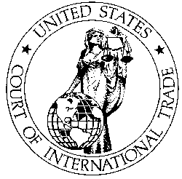
Trade Policy in the Executive Branch and Beyond
Judicial Branch
Court of International Trade (CIT)
Nationwide jurisdiction over civil actions arising out of the customs and international trade laws of the United States.
Examples include:
CBP decisions regarding tariffs, exclusion of merchandise from entry into the US, among other.
AD/CVD decisions by the ITC and Commerce
Decisions of the CIT can be appealed to the U.S. Court of Appeals for the Federal Circuit.

Slide 18
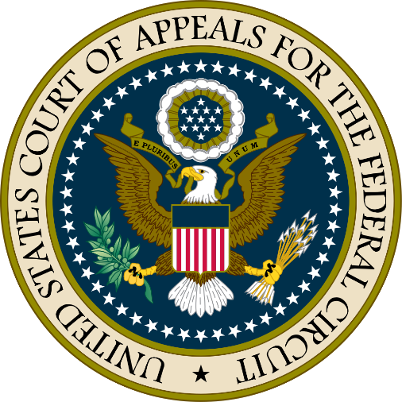
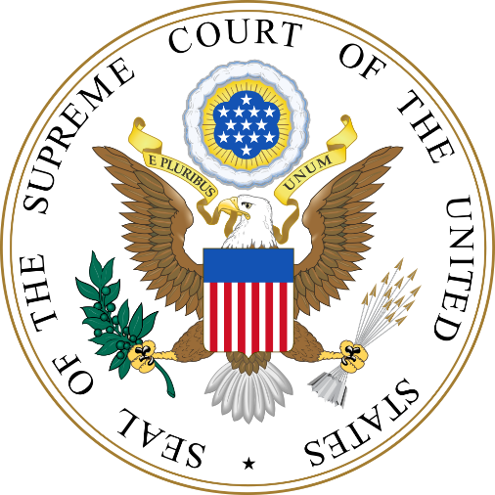
Trade Policy in the Executive Branch and Beyond
Judicial Branch
Court of Appeals for the Federal Circuit (CAFC)
Nationwide jurisdiction in areas including international trade, government contracts, patents, trademarks, certain monetary claims against the U.S. government, and more.
Appeals to the Federal Circuit come from all federal district courts
U.S. Supreme Court
Ultimate appellate jurisdiction over all federal court cases, and over state court cases that involve a point of U.S. constitutional and/or federal law
Original jurisdiction over certain cases, e.g., suits between two or more states and/or cases involving ambassadors and other public ministers
Recent/ongoing cases → Lanham Act extraterritoriality (June 2023), Chevron deference (ongoing)

Slide 19
Trade Policy in the Executive Branch and Beyond
World Trade Organization
Origin
Established in 1995 (Uruguay Round Agreements) → succeeded the General Agreement on Tariffs and Trade of 1947 (GATT)
Role in International Trade
Administering WTO agreements (Customs valuation; trade in goods, agriculture and services; trade remedies; technical barriers to trade; IP rights; government procurement)
Negotiating forum for trade liberalization and rules
Mechanism for dispute resolution
Recent outcomes
Agreement on Fisheries Subsidies (2022), Trade Facilitation Agreement (2017)
Current Challenges
WTO reform
Appellate Body unable to hear cases since 2019 (U.S. Administrations’ refusal to agree to new jurists over concerns of alleged overreach)

Slide 20
Trade Policy in the Executive Branch and Beyond
World Customs Organization
→ Secretary General Ian Saunders
Origin
Established in 1952 as the Customs Co-operation Council (CCC)
Role in International Trade
Only international body dedicated exclusively to international customs and border control matters.
Areas include development of global standards, harmonization of customs procedures, trade supply chain security, facilitation of international trade, enhancement of Customs enforcement and compliance activities, anti-counterfeiting and piracy initiatives,
Maintains the international Harmonized System (HS) → Harmonization System Convention

Slide 21
Trade Policy in the Executive Branch and Beyond
Recent Major Legislative Actions
Infrastructure Investment and Jobs Act (IIJA) – November 2021
Provides $550 billion in new federal spending over 5 years ($16.6B for Ports/Waterways)
Includes the ‘Build America, Buy America Act’
CHIPS and Science Act – August 2022
Includes (1) $52 billion for American semiconductor R&D and manufacturing (2) 25% investment tax credit for manufacturing of semiconductors and related equipment (3) $169.9 billion in scientific R&D funding
US tech companies that receive CHIPS funding barred from building "advanced technology" facilities in China for 10 years
Inflation Reduction Act (IRA) – August 2022
Raises $738B in savings and revenue/ Invests $391B on energy and climate
Includes clean energy and health care provisions and tax reform
Provides electric vehicle tax credits (issue of battery/critical minerals requirements and free trade agreement definition)

Slide 22
Trade Policy in the Executive Branch and Beyond
Pending Legislative Actions
National Defense Authorization Act (NDAA)
Appropriations Bills
American Families and Jobs Act
Farm Bill
GSP/MTB/TAA
Section 321 – De Minimis
Ocean Shipping Reform Act 2.0
21 CCF
Other Trade bills
United States-Taiwan Initiative on the 21st-Century Trade First Agreement Implementation Act

Slide 23
Trade Policy in the Executive Branch and Beyond
Pending Legislative Actions
National Defense Authorization Act (NDAA)
House (H.R.2670) → Passed on July 14. Approved several Trade amendments, mainly targeting China
Senate (S.2226) → Considering amendments. Approved Trade amendments include “Outbound Investment Transparency Act” and “Ending China’s Developing Nation Status Act”
American Families and Jobs Act → Comprised of 3 bills:
Tax Cuts for Working Families Act (H.R. 3936), Small Business Jobs Act (H.R. 3937), Build it in America Act (H.R. 3938)
Farm Bill
Expires September 30, 2023
Senate and House currently drafting new bill → Extension bill likely before
Appropriations Bills
Government funding expires September 30, 2023
Committee approval stage → Congress may pass short-term CR before passing legislation to cover the remainder of FY2024

Slide 24
Trade Policy in the Executive Branch and Beyond
Pending Legislative Actions
GSP/MTB/TAA
American Worker and Trade Competitiveness Act introduced by Rep. Blumenauer on June 22 to reauthorize and update GSP, MTB, and TAA – Co-sponsored by 10 Ways & Means Democrats
Generalized System of Preferences (GSP) | Miscellaneous Tariff Bill (MTB) | Trade Adjustment Assistance (TAA)
Reauthorization through 2026 with retroactivity New criteria on environment, labor, human rights, rule of law, equal protection under the law, and anti-corruption Requires a study on rules of origin, women’s economic empowerment, and GSP utilization rates | Authorizes through December 31, 2024, retroactive four months before enactment and excludes finished products from future MTBs. | Significantly increases funding levels for TAA and expands eligibility

Slide 25
Trade Policy in the Executive Branch and Beyond
Pending Legislative Actions
Section 321 (De Minimis)
June 15 – Import Security and Fairness Act (Bicameral and Bipartisan), Reps. Earl Blumenauer and Neal Dunn and Sens. Sherrod Brown and Marco Rubio
June 14 – De Minimis Reciprocity Act of 2023 (Senate), Sens. Bill Cassidy, Tammy Baldwin, and JD Vance
Import Security and Fairness Act (H.R.4148/S.2004) | De Minimis Reciprocity Act of 2023 (S.1969)
Prohibit use of De Minimis for goods from countries that are both Non-Market Economies and on the U.S. Trade Representative’s (USTR) Priority Watch List (such as China) | Reduce the De Minimis threshold for imports into the U.S. to an amount that matches the threshold of US trade partners (cannot exceed $800).
Require CBP to collect more information on de minimis shipments Prohibit importers that have been suspended or debarred from being able to use de minimis | Bar use of De Minimis for imports from China and Russia and create annual list of countries not eligible for de minimis benefits (criteria includes adherence to UFLPA, transshipment from country on list, exportation of counterfeit goods) Establish a fund for reshoring industry from China. Only allow express carriers to facilitate de minimis imports into the U.S. Require more information on every package entering the U.S.

Slide 26
Trade Policy in the Executive Branch and Beyond
Pending Legislative Actions
Ocean Shipping Reform Implementation Act (H.R.1836)
Introduced March 28 by Reps. Dusty Johnson (R-SD) and John Garamendi (D-CA)
Builds on the Ocean Shipping Reform Act (OSRA) signed into law in June 2022
Prohibits U.S. ports from using Chinese state-sponsored LOGINK software
Allows the Federal Maritime Commission (FMC) to investigate foreign shipping exchanges
Authorizes the FMC to streamline data standards for maritime freight logistics
21st Century Customs Framework
Senate Finance Committee members solicited input in June-July from the Trade community to help craft new customs legislation
Bill Cassidy (R-LA), Marsha Blackburn (R-TN), Catherine Cortez Masto (D-NV) and Maggie Hassan (D-NH)
Input on issues including:
Current barriers and challenges to trade facilitation
Improvements to CTPAT to improve trade facilitation and security
Striking balance between security/enforcement and trade facilitation

Slide 27
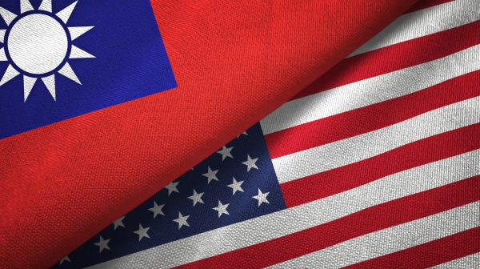
Trade Policy in the Executive Branch and Beyond
Pending Legislative Actions
H.R. 4004 –United States-Taiwan Initiative on the 21st-Century Trade First Agreement Implementation Act
Passed the House and the Senate, awaiting President’s signature
Approves the first trade agreement arising from the U.S.-Taiwan Initiative on 21st Century Trade
Imposes new congressional requirements on the Administration regarding any subsequent agreements under the initiative

Slide 28
Trade Policy in the Executive Branch and Beyond
Pending Legislative Actions (other bills)
Bill | Sponsor(s) | Description
S.2343/H.R.3739 – FAIR TARIFF Act of 2023 | Sens. Bob Menendez (D-NJ) and Bill Cassidy (R-LA), Reps. Brad Wenstrup (R-OH), Mike Thompson (D-CA) | Direct USTR to provide U.S. companies 60-days notice to land goods from market economies in transit before retaliatory tariffs are imposed Refund "goods on the water" tariffs paid following the implementation of the EU retaliatory tariffs (October 2019 & January 2021)
H.R.4538 – BLUE Pacific Act | Rep. Case, Ed [D-HI] | Establish a comprehensive, long-term US strategy and policy for the Pacific Islands, including deepening and diversifying bilateral and multilateral trade between the U.S. and the region and invests in trade capacity building programs for the region.
S.913 – Innovation and Development in Ecuador (IDEA) Act | Sens. Jim Risch (R-ID) and Bob Menendez (D-NJ) | Allow Ecuador to benefit from the Caribbean Basin Economic Recovery Act
S. 153 – Fair Trade with China Enforcement Act | Sen. Rubio, Marco [R-FL] | Safeguard certain technology and IP in the US from export to or influence by the PRC and protect US industry from unfair competition by the PRC
H.R. 4548 – BRIDGE to DRC Act of 2023 | Rep. James, John [R-MI] | Require a national strategy to secure US supply chains involving critical minerals sourced from the Democratic Republic of the Congo
S.1253 - The Securing America's Ports Of Entry Act | Sen. Peters, Gary C. [D-MI] | Increase the number of CBP officers and support staff and require reports that identify staffing, infrastructure, and equipment needed to enhance security at ports of entry.
S.794 – Customs Trade Partnership Against Terrorism (CTPAT) Pilot Program Act of 2023 | Sen. Cornyn, John [R-TX] | Require Department of Homeland Security to carry out a pilot program that assesses whether allowing certain entities to participate in the CTPAT would enhance port security, combat terrorism, prevent supply chain security breaches, or otherwise meet the goals of CTPAT.
H.R. 4443 – Countering China’s Exploitation of Strategic Metals and Minerals & Child and Forced Labor in the DRC Act | Rep. Smith, Christopher H. [R-NJ] | Bar the importation of all goods containing cobalt, lithium and other rare earth minerals mined in the Democratic Republic of Congo (DRC) through child exploitation and forced labor trafficking and to counter China’s control of strategic metals and minerals in the global supply chain.
S.1926 – US-Uruguay Economic Partnership Act | Sen. Menendez, Robert [D-NJ] | Reduce U.S. tariffs on certain Uruguayan exports to the United States. Make Uruguay eligible for E1 and E2 visas for persons involved in trade and investment between the two countries. Strengthen U.S. competitiveness and economic engagement in South America.

Slide 29
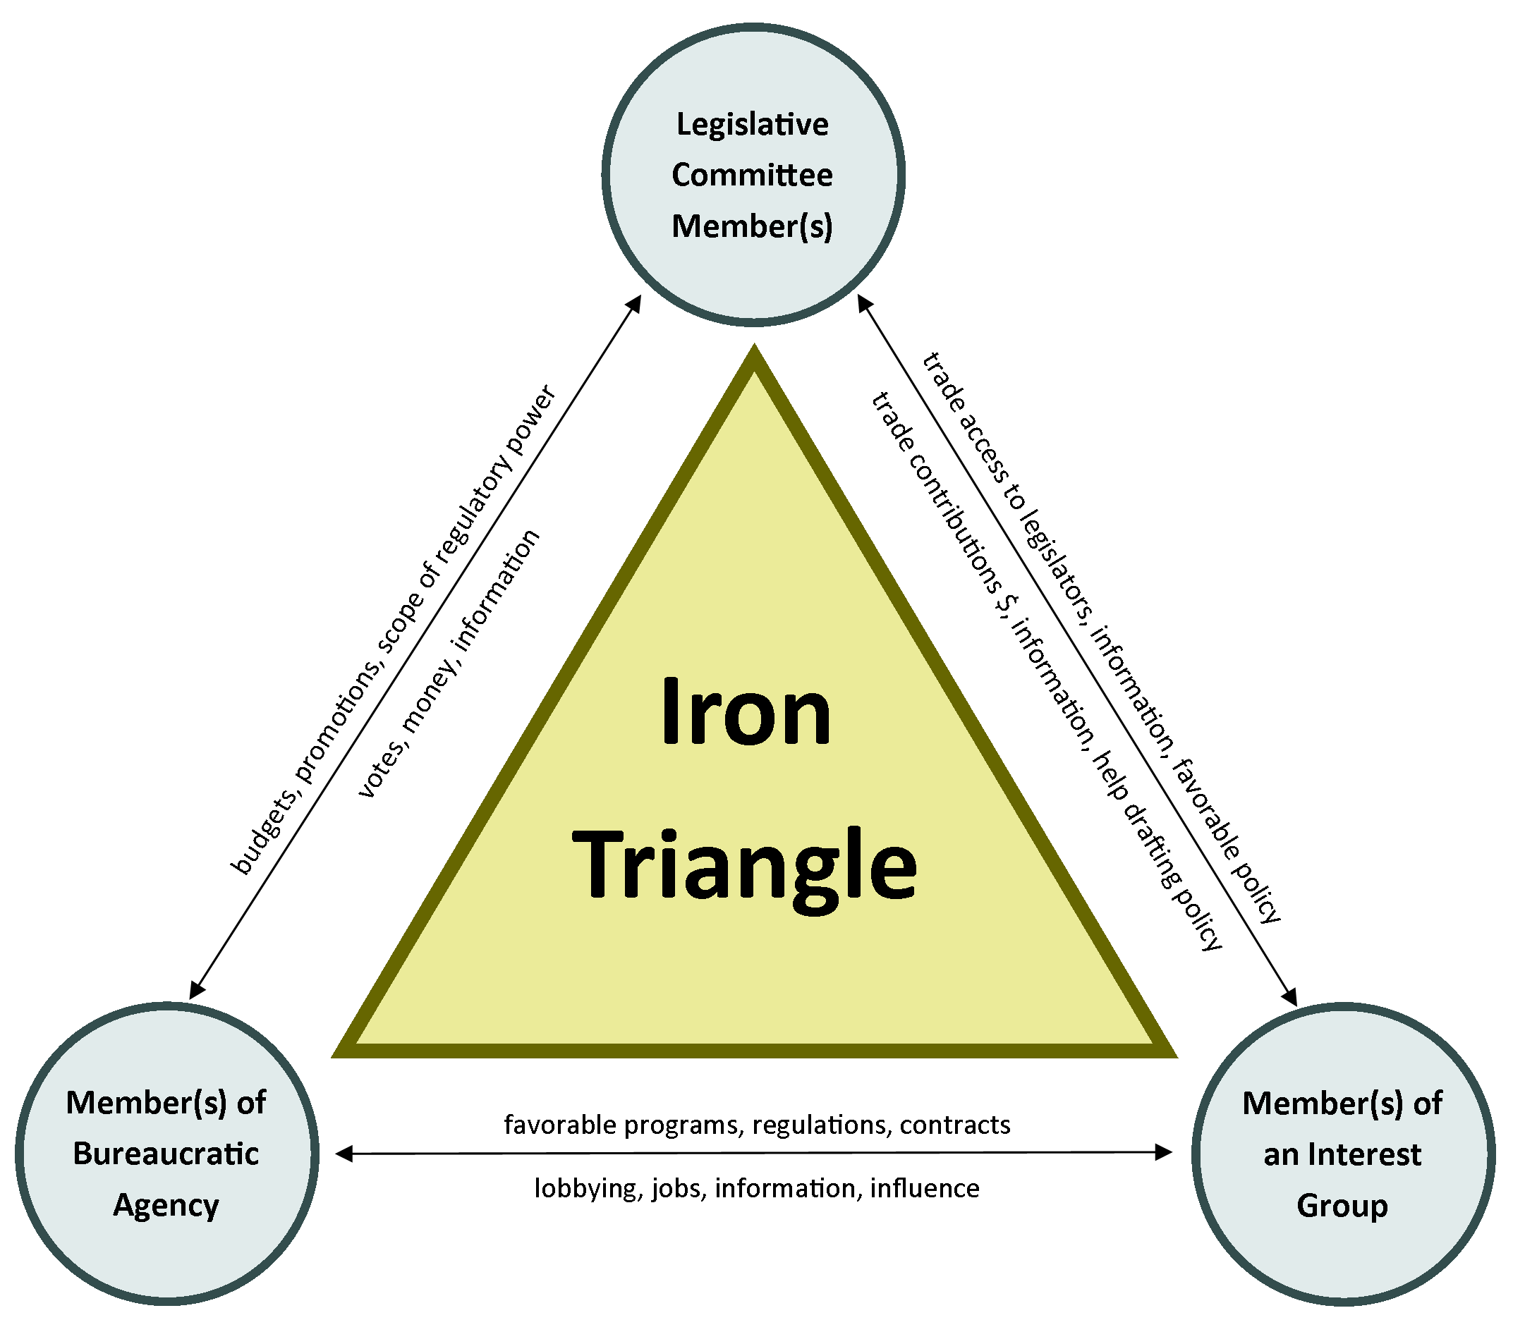
Trade Policy in the Executive Branch and Beyond
This Photo by Unknown Author is licensed under CC BY

Slide 30
Trade Policy in the Executive Branch and Beyond
Questions?
Thank you!

