Slide 1
Amy Magnus, Director Customs Affairs & Compliance
A.N. Deringer, Inc.
Lenny Feldman, Senior Partner, Sandler, Travis & Rosenberg, P.A.
Proposed Regulations & Initiatives– Changing the World of the Broker and Importer

Slide 2
Proposed Regulations & Initiatives– Changing the World of the Broker and Importer
Customs Broker Verification of an Importer’s Identity – Federal Register, August 14, 2019
Continuing Education- Federal Register, September 10, 2021
Modernization of the Customs Brokers Regulations and Elimination of Local Permit – Federal Register June 5, 2020
Senator Bill Cassidy’s Proposals and the 21st Century
Section 321
Global Business Identifier (GBI) – October 6, 2021
Forced Labor
CTPAT Trusted Trader Program

Slide 3
Customs Broker Verification of Importer’s Identity

Slide 4
Customs Broker Verification of an Importer’s Identity – Federal Register August 14, 2019
Proposes minimum requirements for importer and nonresident importer clients to provide information and for customs brokers to collect, verify, and maintain information about the identities of their resident and nonresident importer clients.

Slide 5
Minimum Data – 111.43
(1) The client’s name;
(2) For a client who is an individual, the client’s date of birth;
(3) For a client that is a partnership, corporation, or association, the grantor’s date of birth;
(4) For a client that is a partnership, corporation, or association, the client’s trade or fictitious names;
(5) The address of the client’s physical location (for a client that is a partnership, corporation, or association, the physical location would be the client’s headquarters) and telephone number;
(6) The client’s email address and business website;

Slide 6
Minimum Data – continued
(7) A copy of the grantor’s unexpired government-issued photo identification;
(8) The client’s Internal Revenue Service (IRS) number, employer identification number (EIN), or importer of record (IOR) number;
(9) The client’s publicly available business identification number;
(10) A recent credit report;
(11) A copy of the client’s business registration and license with state authorities; and
(12) The grantor’s authorization to execute power of attorney on behalf of client.

Slide 7
But Wait, There’s More! Verification
The customs broker must verify all the information collected from the client.
The customs broker also must check to determine whether the client is named as a sanctioned or restricted person or entity by the U.S. Government, or if the client is suspended or debarred from doing business with the U.S. Government.

Slide 8
Verification Methods Recommended
(1) A check of the appropriate websites to determine whether the client is named as a sanctioned or restricted person or entity by the U.S. Government, or if the client is suspended or debarred from doing business with the U.S. Government;
(2) An in-person review of the grantor’s government-issued photo identification;
(3) An in-person client meeting;
(4) An in-person visit of the client’s place of business;
(5) A review of the client’s Articles of Incorporation;
(6) A query of publicly available information, business information and credit reporting entities, Federal, state, and local databases or websites and any other relevant trade or business sources.

Slide 9
Internal Controls and Recordkeeping
All customs brokers must implement policies, procedures, and internal controls to identify and verify a client’s identity before transacting customs business on behalf of that client. The policies, procedures, and internal controls must also fulfill the recordkeeping requirements, particularly the requirement for updating information and records, and re-verifying the client’s identity.
Reverification is conducted every 3 years (unless a partnership).
All customs brokers must make, retain, and update records containing the required information used to identify and to verify the client’s identity.

Slide 10
Continuing Education

Slide 11
Continuing Education for Licensed Customs Brokers – September 10, 2021
All individual customs broker license holders must complete 36 hours of qualifying continuing education each triennial period.
Brokers must report and certify their compliance upon submission of the status report.
Brokers must maintain their records of training for 3 years from the date of submission.
Brokers who fail to report and certify continuing education faces suspension of license.

Slide 12
Accreditation of Qualifying Continuing Broker Education
Providers of qualifying training must be offered by one of the following:
Government Agencies
Approved training for continuing education by a CBP-selected accreditor before the training is provide.
Selection of Accreditors
The Office of Trade will select accreditors based on a Request for Information (RFI) and a Request for Proposal (RFP)

Slide 13
Modernization of the Customs Brokers Regulations and Elimination of Local Permit – Federal Register June 5, 2020

Slide 14
Modernization of the Customs Brokers Regulations – Federal Register June 5, 2020
Updates responsible supervision and control oversight framework
Ensures Customs Business is conducted within the US
Requires the customs broker have direct communication with the importer

Slide 15
External Forces Necessitating Change
The establishment of the Centers of Excellence and Expertise
Focuses CBP’s trade expertise on industry-specific issues and creates uniformity of treatment at the ports of entry
Summary review and all Post Entry filings are no longer decided based on geography
Broker regulations are based on the district system which no longer reflects how trade functions are being processed by CBP
The creation of the ACE
Almost completely eliminated the “paper based system” thus reducing the need for brokers to be physically close to the port of entry

Slide 16
Elimination of Local Permit – Federal Register June 5, 2020
Allows Customs Brokers to conduct Customs Business throughout the Customs Territory of the US
Eliminates the District Permit
111.19 and 111.96(c)

Slide 17
Creation of Broker “Office of Record”
The broker will elect his or her “office of record,” the primary brokerage location that oversees the administration of all activities conducted under the National Permit
CBP will assign the broker to an appropriate Center for license and permit administration and become the “primary point of contact” for the broker

Slide 18
Breach of Systems Security – 111.21
Broker must provide notification to his designated Center of any known breach of electronic or physical records relating to the broker’s customs business w/in 72 hours of discovery.

Slide 19
Responsible Supervision and Control
Part of the application for the National Permit will include, “a plan for responsible supervision and control” describing how responsible supervision and control will be exercised over the customs business conduced under the national permit 111.19.
The customs broker must employ a sufficient number of licensed brokers relative to the job complexity, similarity of subordinate tasks, physical proximity of subordinates, abilities and skills of employees, and abilities and skills of the managers.
The former 10 factors to consider for supervision and control morphed into 15 factors.
A slight, but significant change from “all factors” to be considered to “relevant factors” 111.28

Slide 20
The Factors to Consider List 111.28
1. Training provided broker’s employees;
2. Issuance of instructions and guidelines to broker employees;
3. Volume and type of business of the broker;
4. Reject rate for the various customs transactions relative to overall volume;
5. Broker employees’ accessibility to current editions of CBP regulation, HTS, and CBP issuances;
6. Availability of sufficient number of individually licensed brokers for necessary consultation with employees of the broker;

Slide 21
The List 111.28 – continued
7. Frequency of supervisory visits of an individually licensed broker to another office of the broker that does not have an individually licensed broker;
8. Frequency of audits and reviews by an individually licensed broker of the customs transactions handles by employees of the broker;
9. Extent to which the individually licensed broker who qualifies the permit is involved in the operation of the brokerage and communications between CBP and the broker;
10. Any circumstances which indicate that an individually licensed broker has a real interest in the operations of the broker;

Slide 22
The five new factors
11. Timeliness of processing entries and payment of duty, tax, or other debt owing to the Government from which the broker has received payment;
12. Communications between CBP and the broker;
13. Broker’s responsiveness and action to communications, direction and notices from CBP;
14. Communications between the broker and its officer(s);
15. Broker’s responsiveness and action to communications and direction from its officer(s).

Slide 23
False Information 111.32
CBP proposes requiring a broker to document and report to CBP when the broker separates or terminates the broker’s representation of a client as a result of the broker determining the client is intentionally attempting to defraud or otherwise commit any criminal act against the US.
CBP opines they want the broker to act as “force multipliers” in combating fraud and other schemes against the government.
The broker must maintain a record of his advice to the client when issuing “informed compliance” to the client.

Slide 24
The Continued Role of Broker
As CBP moves to collect data earlier in the supply chain, and collect from non-traditional parties, where will the broker fit in?
What will the Importer of Record be responsible for, and what will the broker be responsible for?
Reasonable Care vs. Responsible Supervision and Control over Customs Business
What is Customs Business?
Stay tuned…

Slide 25
The 21st Century Customs Framework

Slide 26
The 21st Century A. Limited Data Collection
Statute | Description | Issue | Considerations
19 USC 1484 | Entry (formal) of merchandise | One step entry process; advance data prior to entry from non-traditional parties | Consider roles, responsibilities and liabilities for advance data
19 USC 1498 | Informal entry of merchandise | Right to make informal entry | Appropriate party to file informal / de minimis entry and liabilities
19 USC 1321 | Administrative exemptions (de minimis) | Data for de minimis entries, advance data prior to de minimis entry | Necessary data and liabilities for advance data

Slide 27
The 21st Century B. Restricted Data Usage
Statute | Description | Issue | Considerations
19 USC 1415 | Mandatory electronic cargo information | CBP authority for data usage | Expansion from safety/ security to any lawful purpose
19 USC 1628a | Exchange of data related to intellectual property enforcement | Providing enhanced shipment info and intermediary or marketplace info involved in import | Role and responsibility of intermediary facilitating such transactions
19 USC 1628b | Exchange of data related to trade enforcement | Providing enhanced shipment info to marketplace or intermediary to support compliance | Role and responsibility of intermediary receiving such info

Slide 28
The 21st Century C. Narrow Visibility & Accountability
Statute | Description | Issue | Considerations
19 USC 1508 | Recordkeeping | Broaden requirements to cover marketplaces and non-traditional parties | Responsibility should be known and commensurate to role in transaction
19 USC 1509 | Examination of books and witnesses | Apply adverse inference if fail to comply | Reasonable, knowing standards, not strict liability

Slide 29
The 21st Century D. Untimely & Ineffective Enforcement 1. Preventing Loss of Revenue
Statute | Description | Issue | Considerations
19 U.S.C. 4320, 1321, 1498 | Importer of record program | CBP’s ability to prohibit suspended or debarred parties from importing | Use of SAM exclusion list; federal-wide system; ACE flags
19 USC 1623 | Bonds and other security | Updating bonding requirements and conditions; information sharing with sureties | Bond sufficiency/ security standards; surety visibility, SOL period, interest calculation
19 USC 1517 | Investigative procedures for AD/ CVD evasion claims | Permitting CBP to disclose importer not named in EAPA allegation | Time frame (due process); changed circumstances prior to determination

Slide 30
The 21st Century D. Untimely & Ineffective Enforcement 2. Streamlining Enforcement to Protect Assets/Consumers
Statute | Description | Issue | Considerations
19 USC 1526(e), 1595a(f), 1607 | Seizure and forfeiture of IPR infringing or other inadmissible goods | Application of summary forfeiture | Proper and adequate notice, due process; value threshold
19 USC 1499 | Examination of merchandise | Voluntary abandonment | Proper and adequate notice, due process; value threshold
19 USC 1514(a)(4) | Protest against ITC section 337 exclusion order | Challenge with ITC (not with CBP) | ITC regime due process, time frames

Slide 31
The 21st Century D. Untimely & Ineffective Enforcement 3. Driving Trade Compliance through Expanded/Streamlined Penalties
Statute | Description | Issue | Considerations
19 USC 1526(f) | Fines for counterfeit goods | Expansion of parties concerned with unlawful activity | Knowledge, not strict liability standard due to additional, non-traditional parties
19 USC 1436 | Penalties for arrival, reporting, entry and clearance requirements | Expanding penalties against other concerned parties | Knowledge, not strict liability standard due to additional, non-traditional parties
19 USC 1595a(b), a(d)-(e) | Penalties for aiding unlawful import/ export | Assess penalties for inadmissible goods without seizure | Disposition of goods; types of violations; penalty regime
19 USC 1592 | Penalties for fraud, gross negligence and negligence | Remove gross negligence; redefine culpability; direct DOJ referral (fraud) | Elevation of gross negligence to fraud; appropriate due process
New Provision | Obstruction of Investigation | Penalty for parties who destroy, hide assets or alter evidence | Showing of intent, materiality; is provision needed; appropriate penalty amount (value of concealed funds/assets or 3x penalty)

Slide 32
Section 321

Slide 33
Proposed Data Fields for the new Section 321 Requirements
Identifier (BOL or unique ID)
Country of Shipment
10 digit HTS
Conditional Data Fields
Sellers name and address
Purchaser name and address
Retail advertised description
Market place name, web site and phone number
PGA data
1 or more of the following
URL, Picture, SKU or Product ID, XRAY or Scan, or Security Screening

Slide 34
GBI or Other Party Identifiers

Slide 35
Global Business Identifier (GBI) October 6, 2021
The Manufacturer ID (MID) is not working
CBP is seeking alternatives to the MID
The Evaluative Proof of Concept (EPoC) will assist CBP in determining a single identifier solution that will uniquely discern main legal entity and ownership, specific business and global locations, and supply chain roles and functions.
How will CBP identify the non-traditional parties in the supply chain, and how will these parties identify themselves?

Slide 36
Number, Numbers, Numbers Which entity identification systems might be impacted by the GBI?
*The full list of entity identification systems can be found in “Envisioning Comprehensive Entity Identification for the U.S. Federal Government” published by Data Foundation and GLEIF in 2018

Slide 37
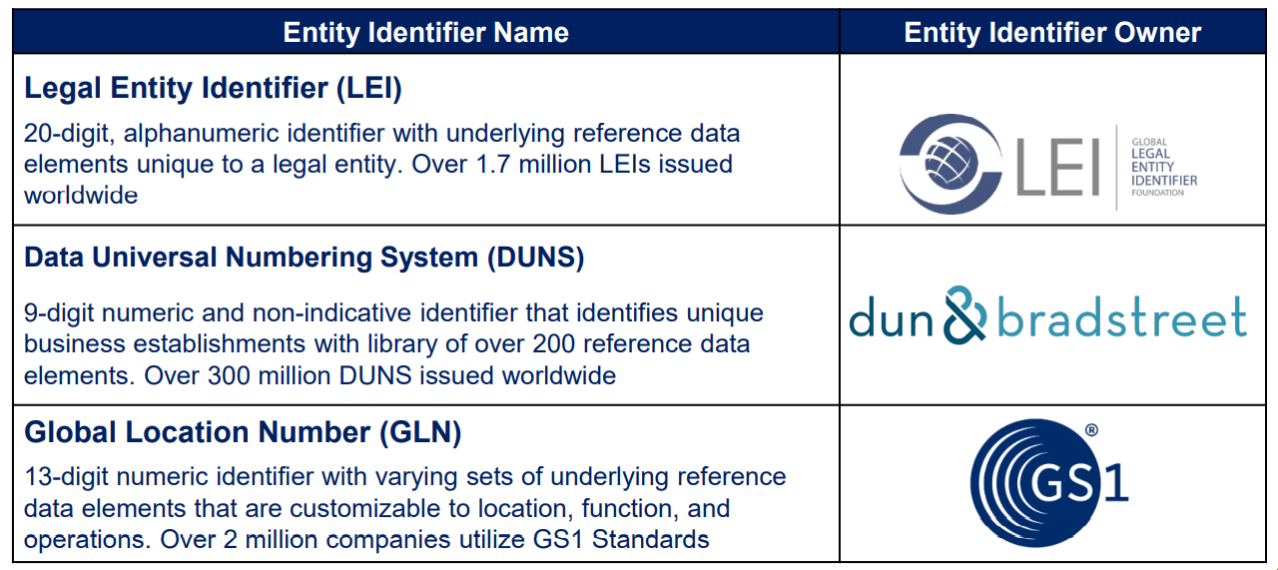
The three GBI’s in the EPoC

Slide 38
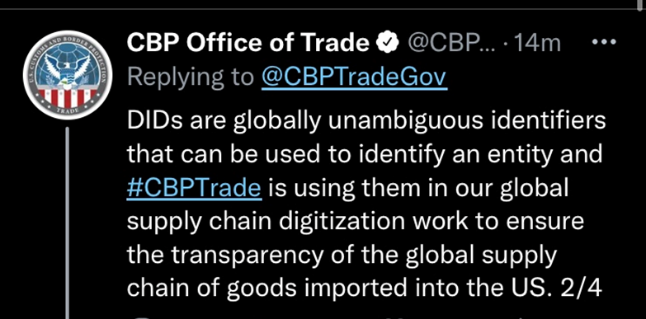
DID’s?

Slide 39
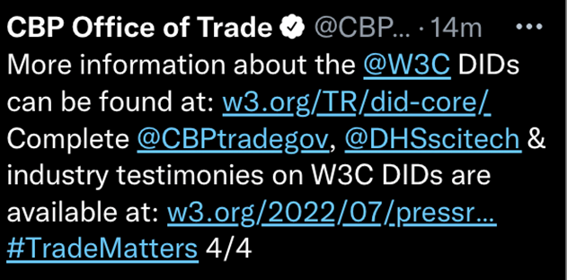
DID’s Continued

Slide 40
CTPAT Trusted Trader and Forced Labor

Slide 41
CTPAT Trusted Trader Program
Handbook now available
Applicants will be accepted August 1
Requirements must be in place for new applicants
For existing Trusted Traders (formerly ISA) one year to implement all new requirements

Slide 42
Forced Labor and CTPAT Trusted Trader
Risk based mapping
Code of Conduct
Evidence of Implementation
Due Diligence and Training
Remediation Plan
Shared Best Practices

