Slide 1


Member Benefits 2024

Slide 2
What is NCBFAA?
Headquartered in the Washington DC metro area
Represents more than 1,300 member companies with 110,000 employees in international trade
The nation's leading freight forwarders, customs brokers, ocean transportation intermediaries (OTIs), NVOCCs and air cargo agents, serving more than 250,000 importers and exporters.
The Association’s members handle more than 97% of the entries for goods imported into the United States and are directly involved with the logistics of these goods.
Our members operating as OTIs are involved with approximately 80 to 85% of all exports from the United States.

Slide 3

Networking & Advocacy
NCBFAA Annual Meeting
Government Affairs Conference (GAC)
Lobby Day
NCBFAA Board Meetings
NCBFAA Committees

Slide 4
NCBFAA Membership Directory
Notes:
Online version of the directory can be accessed only by members
Print version is sent to all members each Spring
Keep your directory listing up to date by entering current data and description of your products and services in Member Max
Full- and half-page advertisements are available for a fee

Slide 5

Monday Morning E-Briefing
Notes:
MMeB is a weekly email compendium of updates and industry resources
Offer your company discounts to fellow members in the MMeB at no charge
Reaches over 10,000 subscribers

Slide 6

Host a Webinar with NCBFAA
Notes:
Utilize the NCBFAA webinar platform and support staff to host a webinar to advertise your products and services (up to two times a year)
Webinars are offered free to all members and advertised in the MMeB
After the webinar the host member will receive a complete listing of webinar attendees
A link of the archived webinar will be available to attendees that missed the live version

Slide 7

Earn Continuing Education Credit
Notes:
Free Webinars
Members enjoy 30% discount from NCBFAA Educational Institute (NEI)
NEI offers webinars and certification programs online
Topics include international trade, supply chain management, global logistics, customs brokerage, export transactions, transportation, attendant government regulation, etc.

Slide 8

Members Only Free Access to Resources
Free documents designed exclusively for members (nonmembers pay $1,500 per year per item)
NCBFAA Power of Attorney
NCBFAA Terms & Conditions
NCBFAA Bill of Lading
Shipper's Letter of Instruction Model
USPPI Responsibility Information Sheet
ACE Toolkit

Slide 9

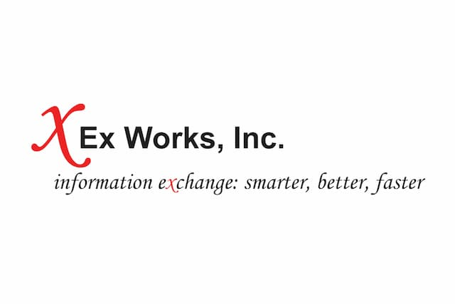
Shippers Association save money on contracts savings up to $5K a year or more depending on volume per year
Ex-Works, Inc.
free trucking vetting services
worth up to $48,000 a year

Slide 10




NCBFAA Professional Partners
Monex,USA
Altigro
Paychex
Insurance
offers our members access to foreign currency exchanges, discounted wire transfers and more
retirement and wealth building solutions
offers a discounted one-stop-shop for HR, Payroll, Insurance, and benefits administration (discount up to 15%)
10% discounts on insurance from Affiliate Members Avalon, Roanoke, IB&M and others (worth hundreds to thousands of dollars)

Slide 11
Elevating the success of our members is our goal
Contact Amy Dawson Taggart, National Membership Director at membership@ncbfaa.org
Contact membership team representative at (202) 466-0222
Notes:
For more information about how to get involved in NCBFAA and get the most out of your membership:

